Slide 1





Sales Forecasting for Furniture Store
- Prerak Pandya
This Photo by Unknown Author is licensed under CC BY-NC-ND

Slide 2

Problem Statement: For a retail furniture store, predicting future sales is critical to avoiding inventory issues like overstocking or under-stocking. The challenge lies in utilizing time series data from the superstore dataset to forecast furniture sales for the next year accurately. This predictive insight ensures an optimal customer experience, avoids losses, and maintains store sustainability.

Slide 3

Step to Slove Problems
- Data Collection and Preparation
- Exploratory Data Analysis (EDA)
- Model Selection
- Model Training and Validation
- - Forecasting and Evaluation:
- Conclusion
-

Slide 4
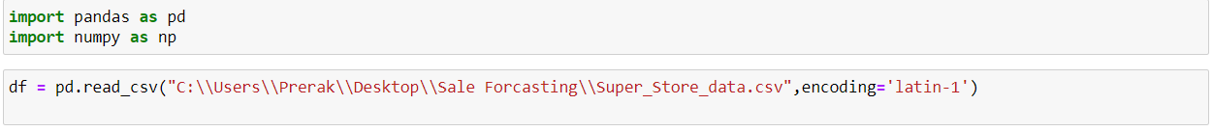
Data collection and preparation
Import library’s pandas ,Numpy
With use of pandas lib import data

Slide 5
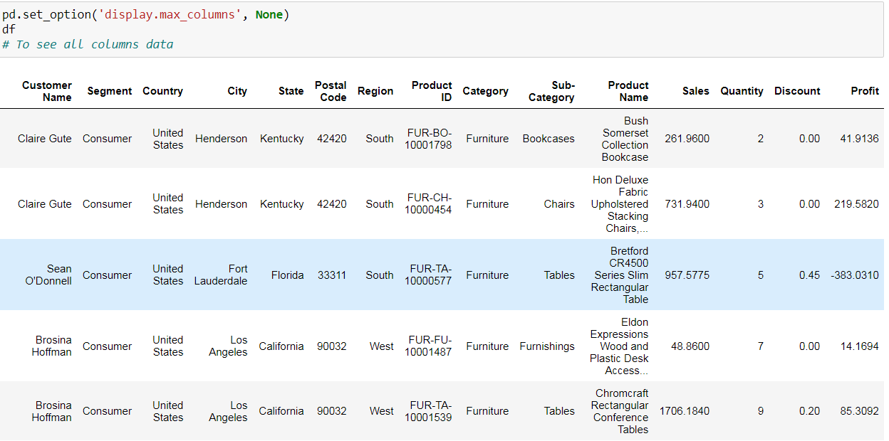
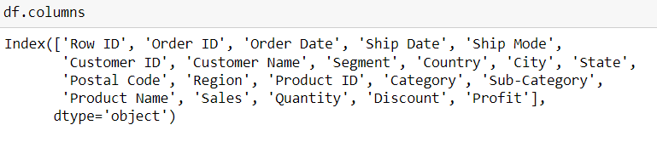
DATA

Slide 6
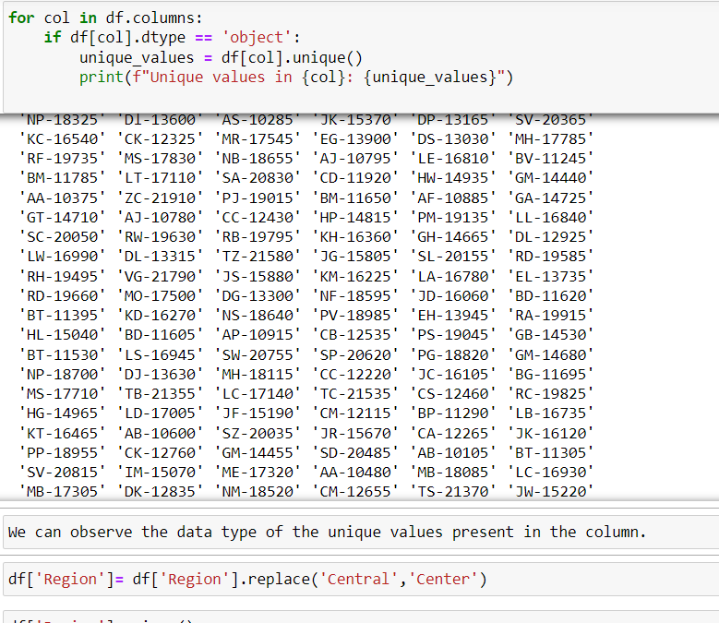
Check Unique values

Slide 7
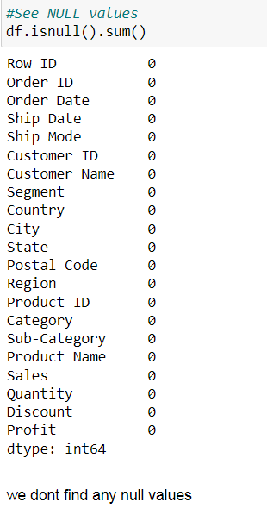
Check null value

Slide 8
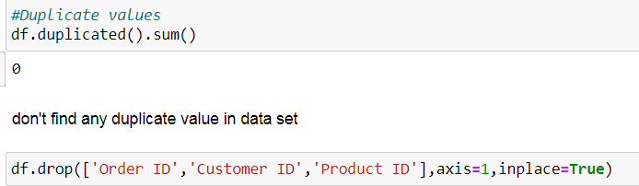
Check duplicates values drop columns who not needed forecasting

Slide 9


Model selection
Here we select order id and sales columns because we forecasting sales for next 1 year
Here we use groupby function on order data columns and sum for sales column so this method will help to reduce noise in data

Slide 10
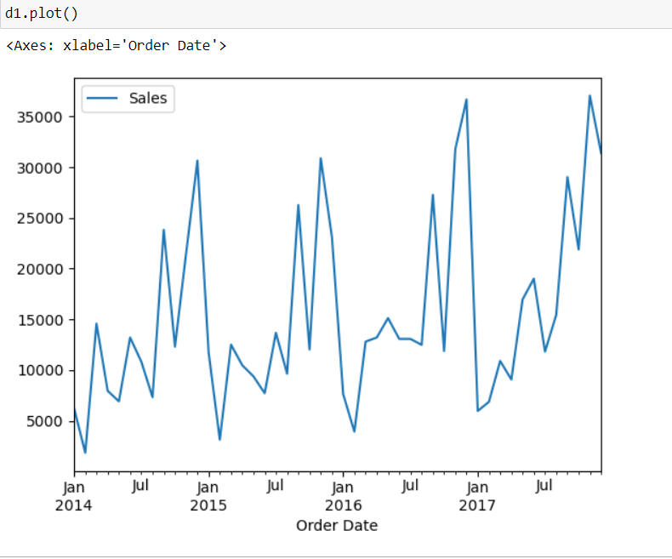
Month wise sales is ready

Slide 11
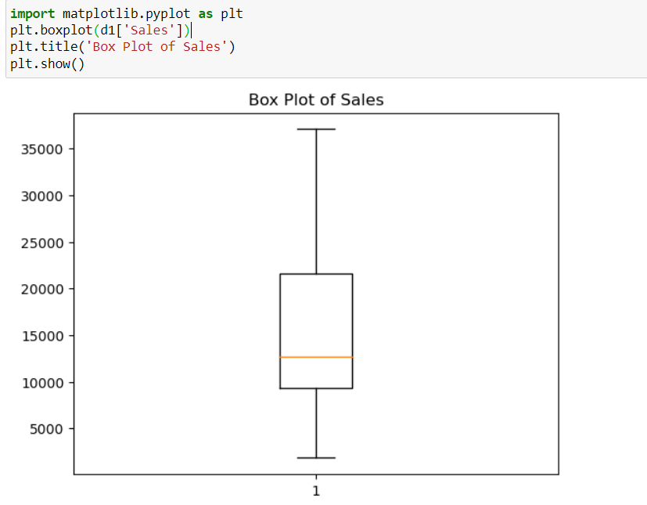
Check outliers
Here we see ,no outlier we found
In case of outlier then we should decide that we drop or continue with outliers depend on dataset, requirement, domain knowledge

Slide 12
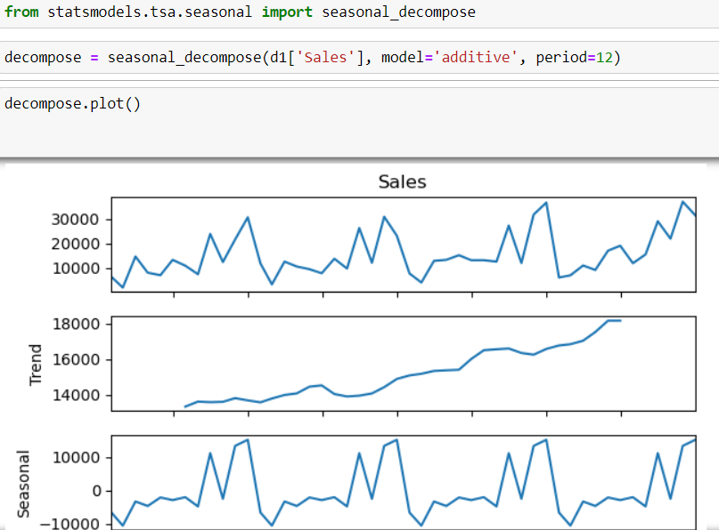
data is seasonal or not
Before apply model, we can check data is seasonal or not
Check seasonality we use seasonal decompose
Here, clearly see the data is seasonal

Slide 13
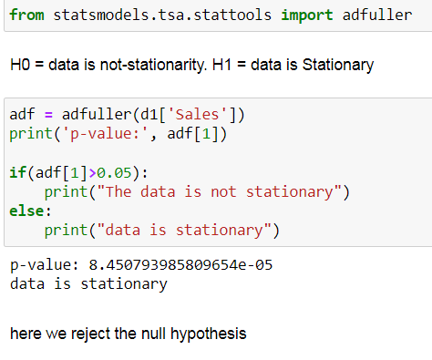
data is stationary or not
Stationary means, mean and stander deviation of data should constant
For check, we use adfuller test called Augmented Dickey-Fuller test
In our case data is stationary

Slide 14
If data is not stationary
In, our case data is stationary but if not then we use serval method to data convert to stationary format
1)Rolling method
2)Differential method
3)Square method

Slide 15
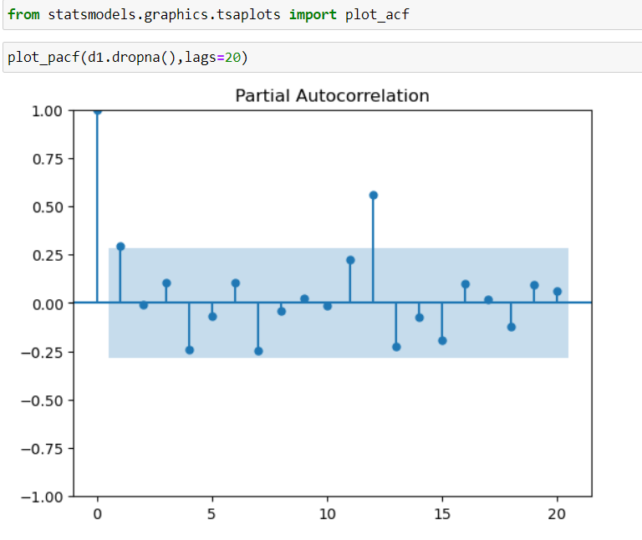
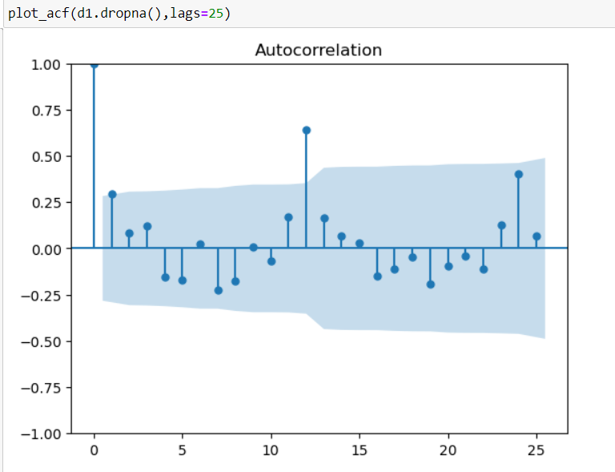
Arima model
First, we use Arima model
Before use Arima we need p,d,q value
p = Auto aggression
d = integer
q = Moving average
To find this value we import acf and pcf plot

Slide 16
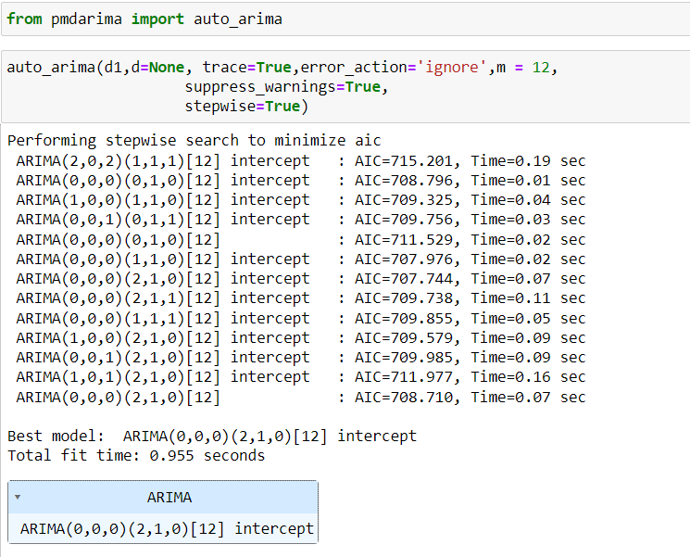
Auto arima
We can also use auto Arima to find p,d,q values
In auto Arima p,d,q value find automatically where in acf,pcf plot we decide manually

Slide 17
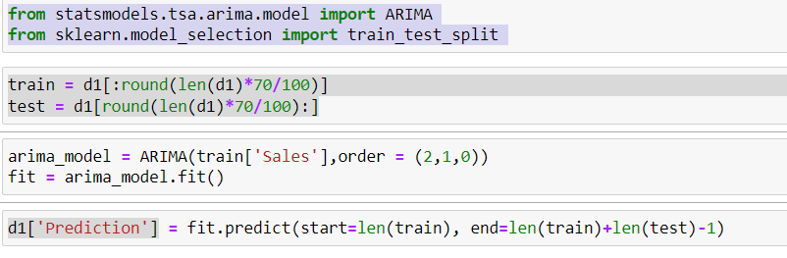
Arima
Import library
+
Split data into train and test
+
Build model and fit the model
+
Predict the model

Slide 18
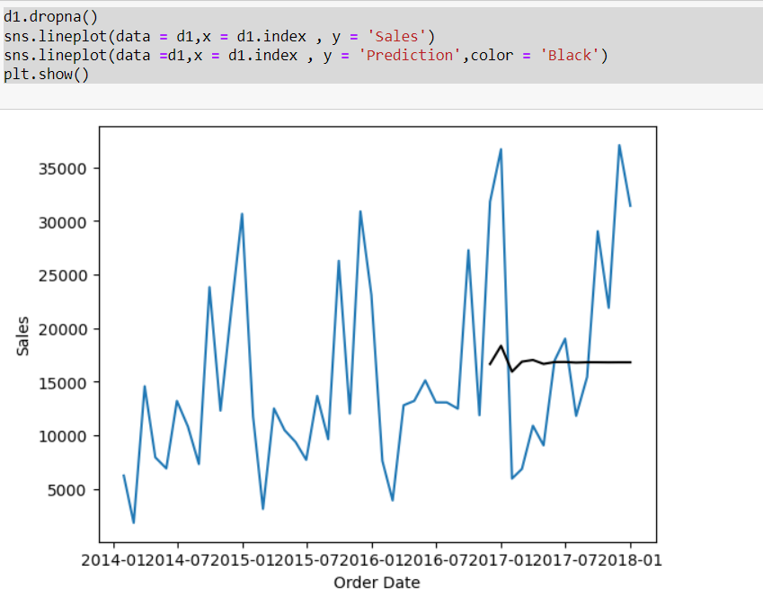
Here we see test data is not accurate

Slide 19
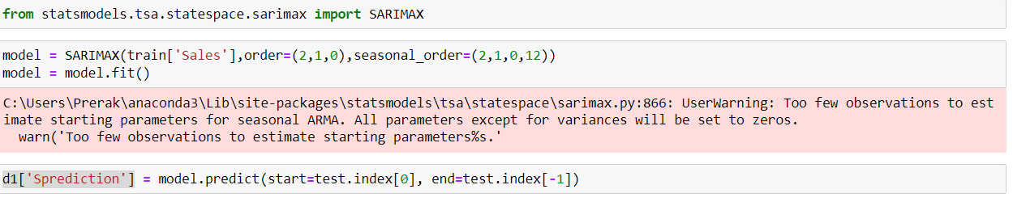
sarimax
Lets's jump in second forecasting model called sarimax when data is seasonal then we use this model maximum time
Import library
+
Split data into train and test
+
Build model and fit the model
+
Predict the model

Slide 20
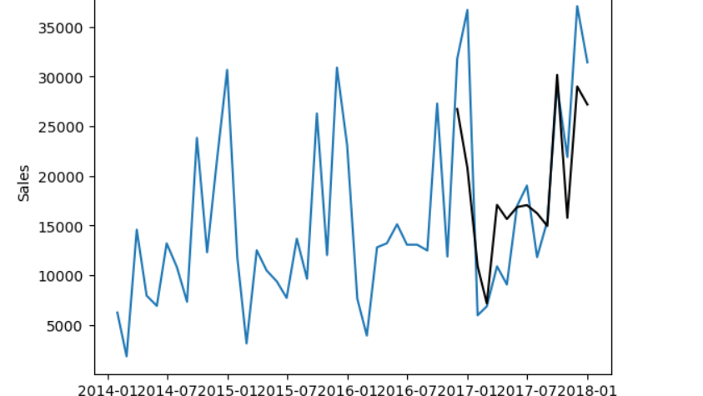
Here our test data perform far batter than arima model

Slide 21
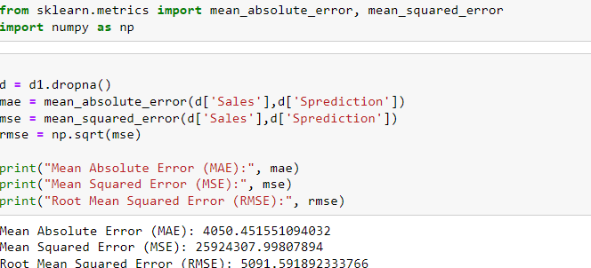
model EVALUTION
We are using mean square error as a measure to evaluate the accuracy of our model.

Slide 22
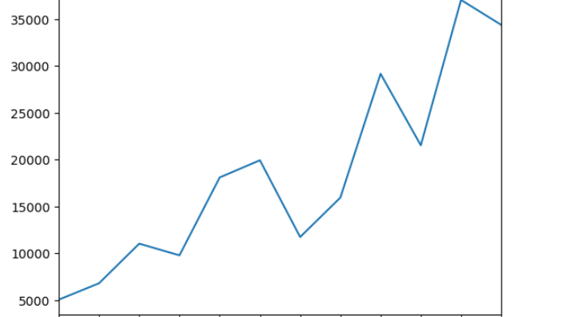
Forecast For next 12 months

Slide 23
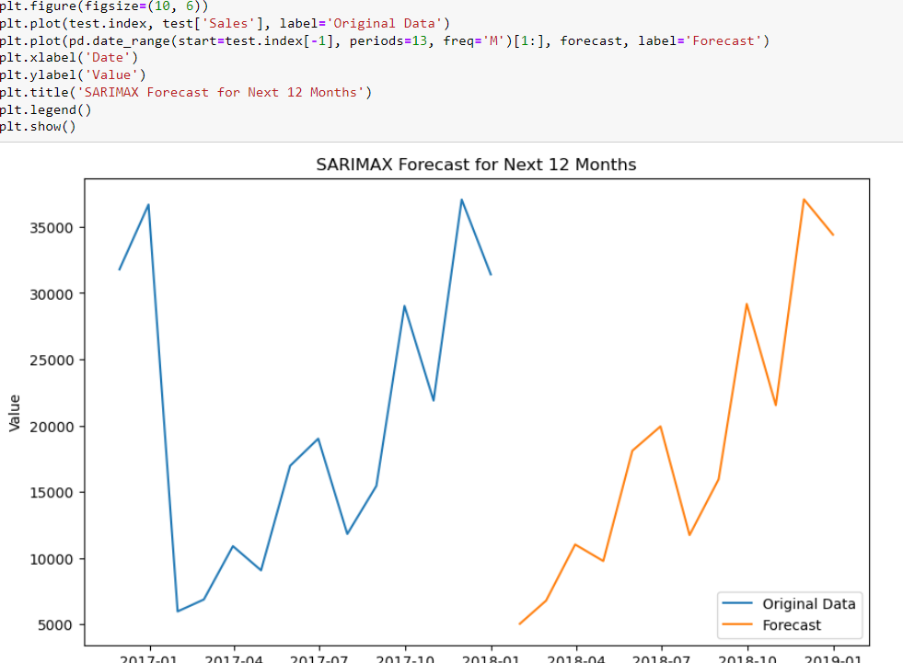

Slide 24
Random Forest
Even though SARIMAX performs better than random forest, we still do not achieve good accuracy.

Slide 25
Conclusion
We will provide a forecast for the next 12 months to assist in managing store inventory and avoid any losses

